Slide 1

Apartment, and home repairs ,infrastructure and equipment issues
Group 7:
Reema Gattupalli
Venkata Siva Ram Pande Kalivela
Geetika Sai Manne
Swarna Neella
Pravallika Obulapuram
Keerthi Chandra Vemulamada

Slide 2

An In-depth Analysis of Maintenance for Owned and Rented Properties
Introduction
Primary objectives
Collection
Storage
Processing
Analysis
Management
References

Slide 3
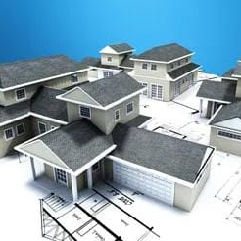
INTRODUCTION
In considerations of comfort, safety, value preservation, and financial savings, apartment and house maintenance is essential. Renters and homeowners share responsibility for it, and legislative requirements guarantee adherence to the law and everyone's safety.

Slide 4
PRIMARY OBJECTIVES
Enhance efficiency of apartment and home repair processes.
Improve infrastructure and equipment reliability.
Utilize data-driven insights to anticipate and prevent common issues.
Ensure safety and comfort for residents through timely maintenance.

Slide 5

DATA COLLECTION
Our data sources : Three static datasets
1. Louisville Metro KY – Home Repair
Website: https://hub.arcgis.com/datasets/bee1d8b1ef1c44db82d696bc1d63e369_0/explore
2. Property Maintenance Data website: https://www.phoenixopendata.com/dataset/property-maintenance-data.
3. Individual Assistance Housing Registrants - Large Disasters (NEMIS) website: https://catalog.data.gov/dataset/individual-assistance-housing-registrants-large-disasters-nemis

Slide 6

Data Processing:
The collected data is the raw one and by using the Open Refine tool we cleaned the data
We have addressed issues with missing values, null entries, and duplicates, thereby enhancing the data's readability and processability.

Slide 7
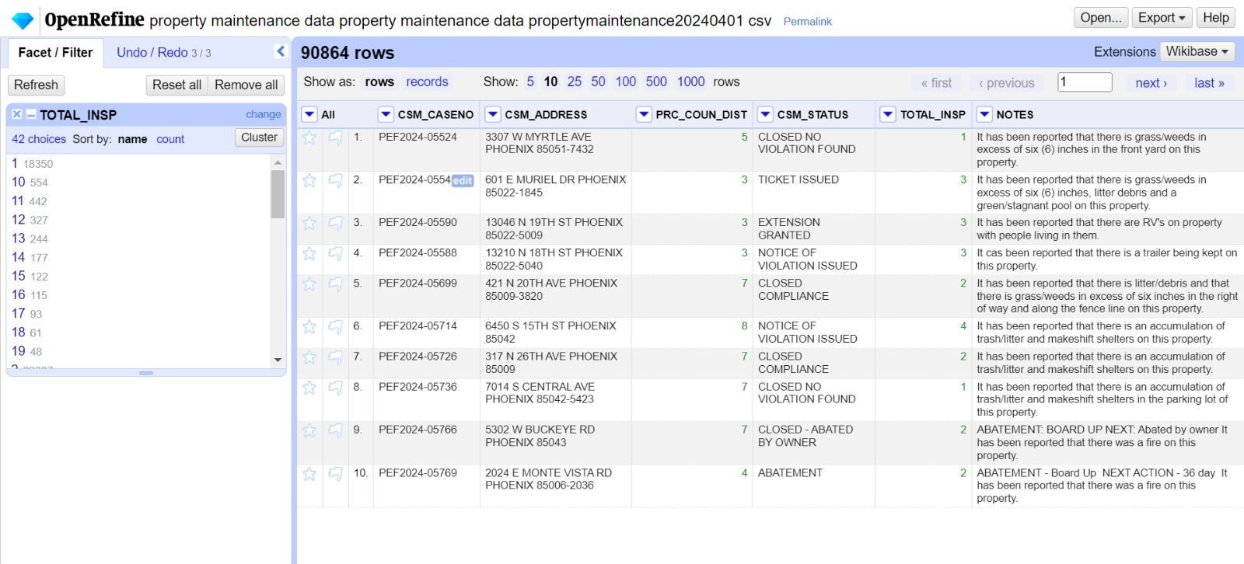
Open Refine

Slide 8

Data Storage
The processed data is securely held in Google Cloud Platform through the creation of storage buckets, ensuring straightforward access and retrieval throughout the duration of the project.

Slide 9
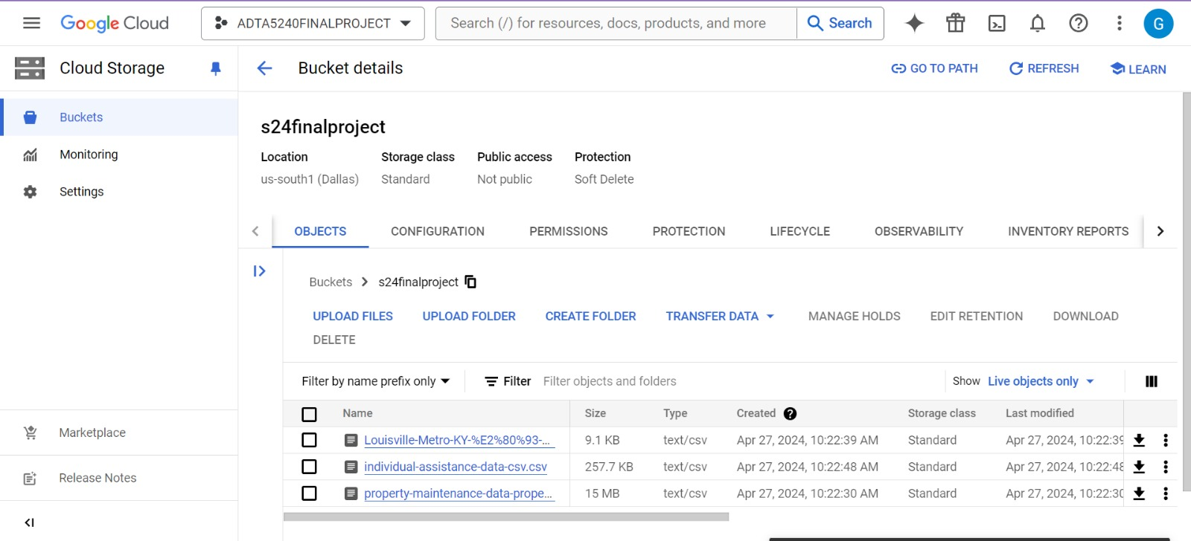

Slide 10

Data Management
Our project leverages Google Cloud's Big Query for efficient data warehousing, Apache Hive for data summarization and querying, and Apache Spark for high-speed analytics and data processing. This integrated approach enables us to handle vast datasets with ease, ensuring both speed and scalability while providing comprehensive insights through advanced data analytics.

Slide 11
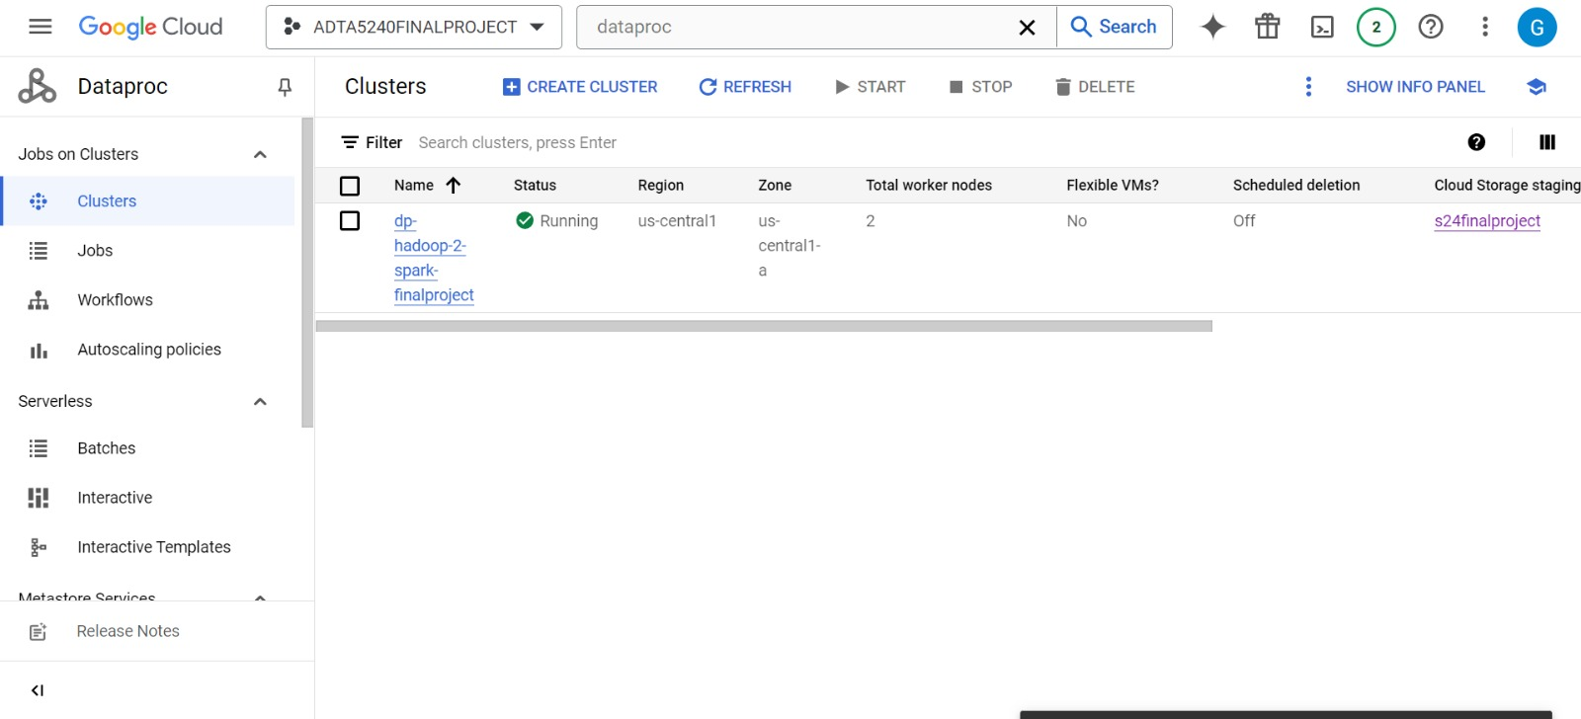
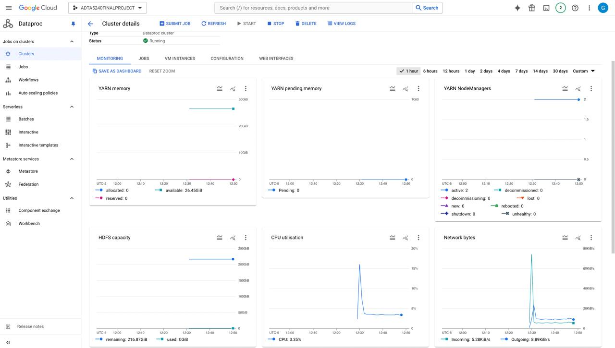
MANAGEMENT

Slide 12
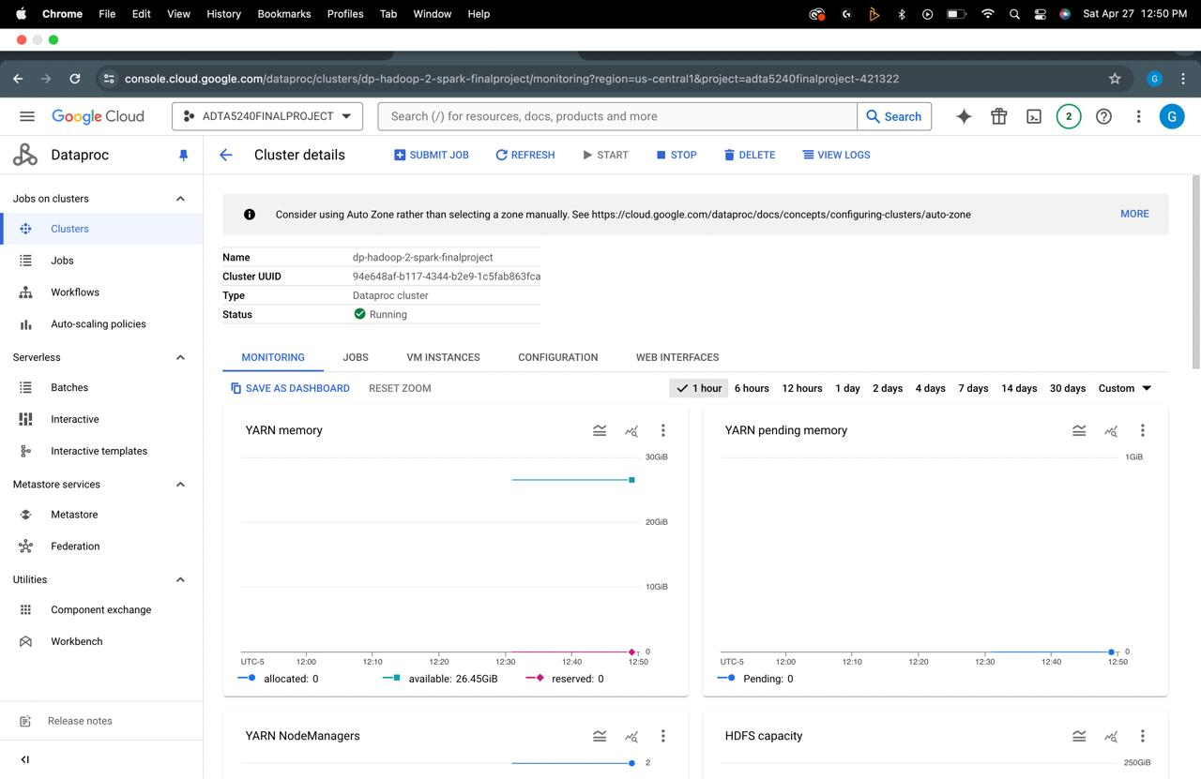
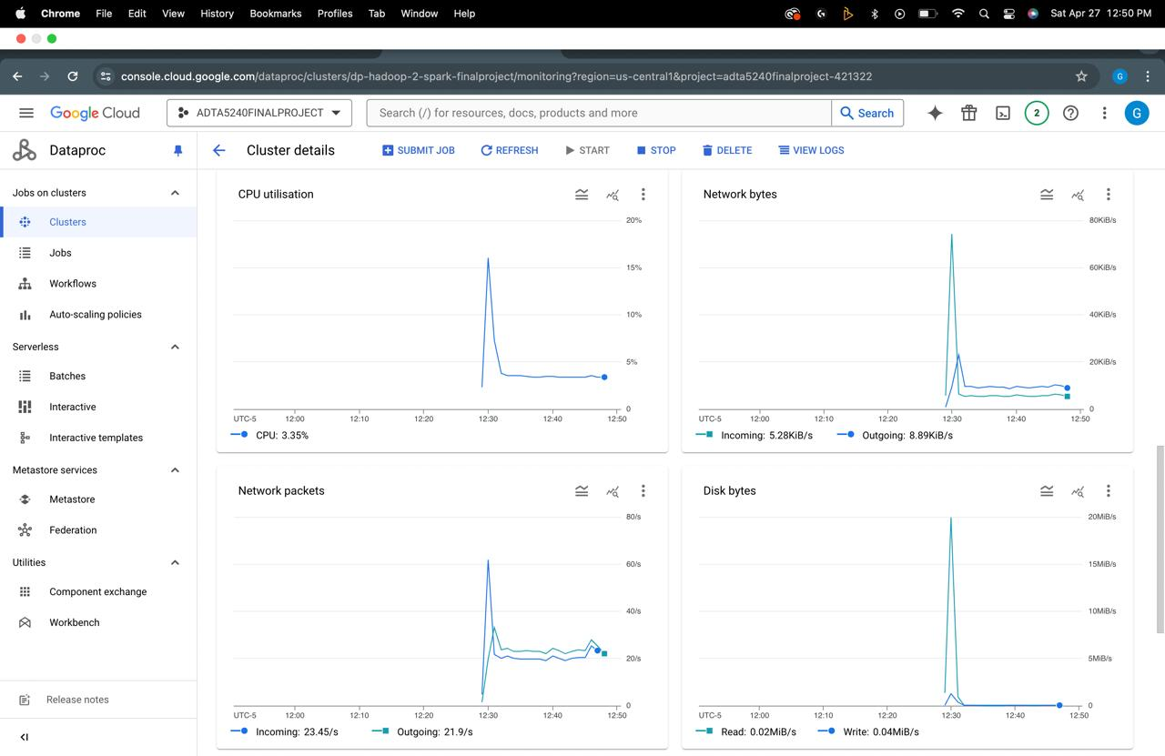

Slide 13
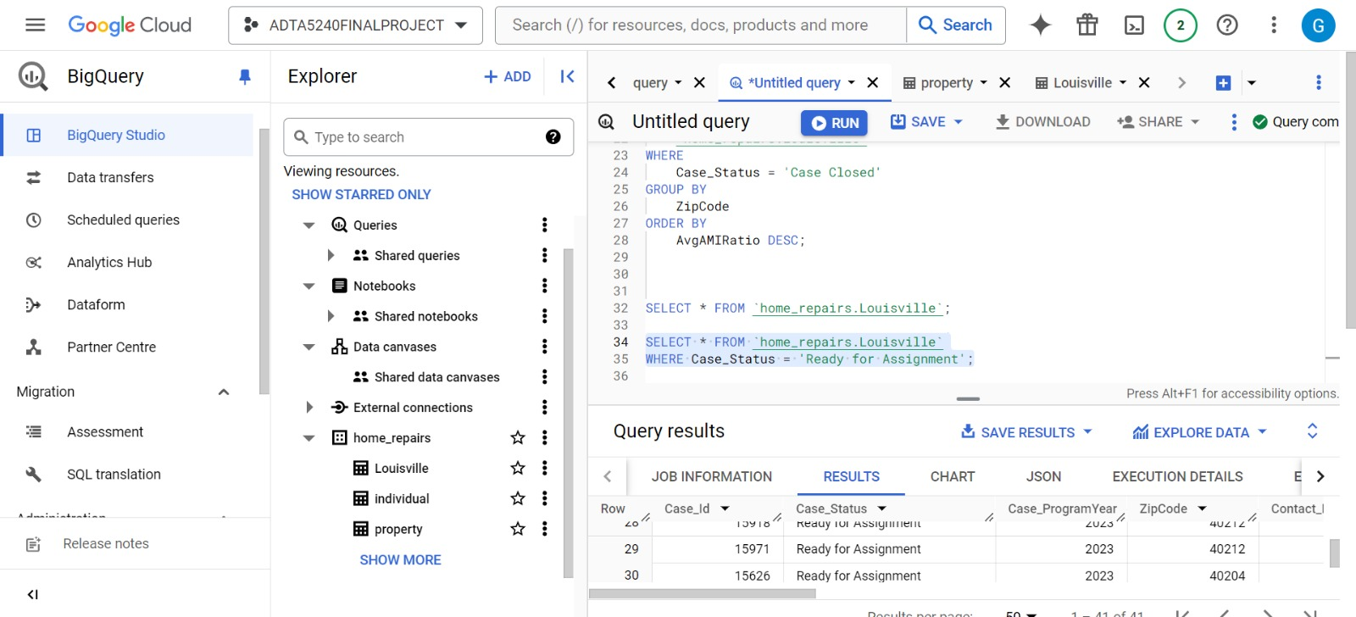
.Big query

Slide 14
Video
Swarna’s Video:
https://youtu.be/gmmrjZPo5LE?si=sQ710w0Wivrvp3TN

Slide 15
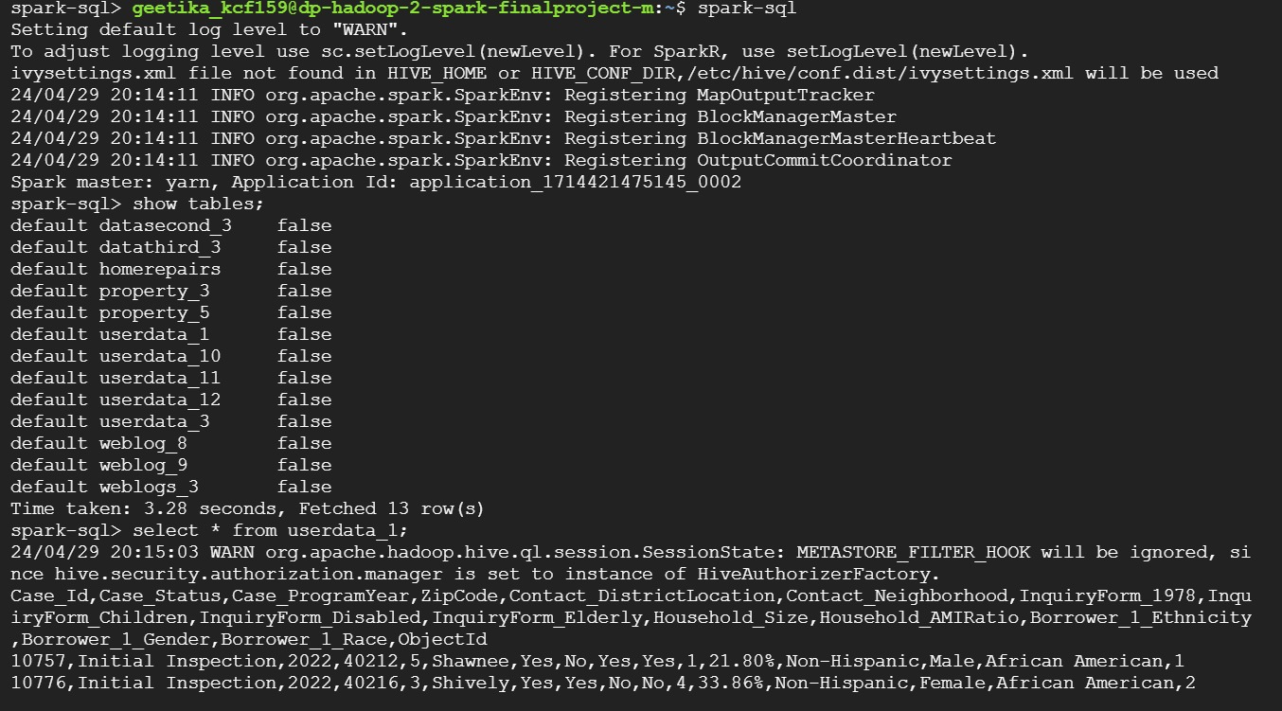
Spark SQL

Slide 16
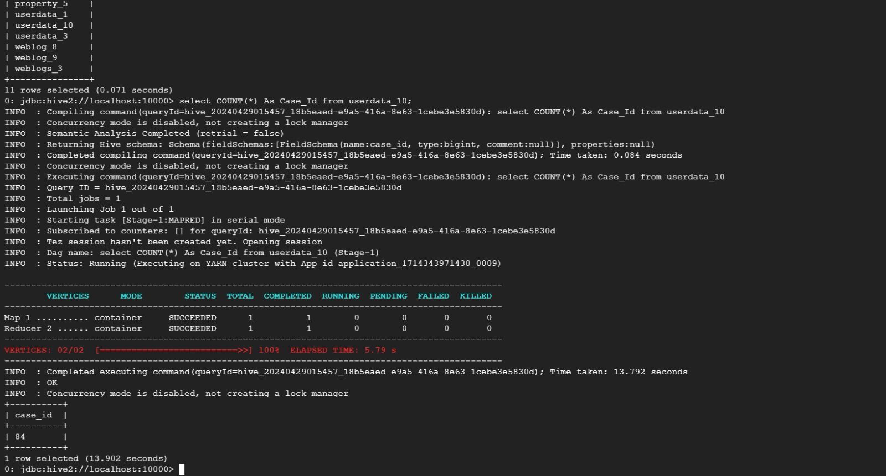
Hive

Slide 17
Conclusion
As data engineers we effectively managed and processed data on Google Cloud Platform, optimizing building repair and maintenance operations through advanced analytics and infrastructure management. Our work ensures enhanced decision-making and operational efficiency in residential and commercial property upkeep.

Slide 18
Data Sources and References:
1. Louisville Metro KY – Home Repair
Website: https://hub.arcgis.com/datasets/bee1d8b1ef1c44db82d696bc1d63e369_0/explore 2. Property Maintenance Data website: https://www.phoenixopendata.com/dataset/property-maintenance-data. 3. Individual Assistance Housing Registrants - Large Disasters (NEMIS) website: https://catalog.data.gov/dataset/individual-assistance-housing-registrants-large-disasters-nemis

Slide 19


